Slide 1
IPL SCORE PREDICTION USING GAN
Created by
Ramachandharan .V
Reg.No.:912321104036
III-year , CSE
SACS MAVMM ENGINEERING COLLEGE

Slide 2
Project outline:
Problem statement
Proposed system/solution
System developmet approach
Alogithom and deployment
Result
conclution

Slide 3
Problem Statement:
Design and develop a Generative Adversarial Network (GAN) algorithm to predict cricket scores for matches in the Indian Premier League (IPL). The model should take into account various factors such as team performance, player statistics, pitch conditions, weather, and historical match data to generate accurate and reliable predictions. The goal is to create a predictive model that can forecast the total score of each team in an IPL match with high precision, thereby assisting fans, analysts, and stakeholders in making informed decisions and enjoying the game better.

Slide 4
Proposed system/solution
Data Collection:
Gather a comprehensive dataset of historical IPL match data including various features such as venue, teams, player statistics, weather conditions, etc.
Data Preprocessing:
Cleanse and preprocess the dataset to remove any inconsistencies or irrelevant information. This may involve data normalization, handling missing values, and encoding categorical variables.

Slide 5
Proposed system/solution:(contd…)
3. GAN Architecture:
Design a GAN architecture suitable for generating IPL match scores. The GAN consists of two main components:
Generator:
This component generates synthetic match scores based on random noise or input features.
Discriminator:
This component distinguishes between real and synthetic match scores. It evaluates the output of the generator and provides feedback to improve its performance.
4.Training the GAN:
Train the GAN using the preprocessed IPL dataset. The generator learns to generate realistic match scores while the discriminator learns to distinguish between real and generated scores.

Slide 6
Proposed system/solution:(contd…)
5.Evaluation:
Validate the performance of the trained GAN using various metrics such as accuracy, precision, recall, and F1-score. Additionally, assess the realism of generated match scores through visual inspection and statistical analysis.
6.Deployment:
Deploy the trained GAN model as a prediction system where users can input relevant match parameters (teams, venue, player stats, etc.) to generate predicted scores for upcoming IPL matches.
7.Continuous Improvement:
Continuously update and fine-tune the GAN model with new data to improve its predictive accuracy and adaptability to changing match conditions.

Slide 7
System developmet approach:[Hardware Requirements:]
Computing Power:
GANs typically require significant computational resources, especially during training. You'll need a powerful CPU/GPU setup. Consider using high-end GPUs like NVIDIA Tesla or GeForce RTX series for faster training.
RAM:
Sufficient RAM is essential, especially for handling large datasets and model parameters during training.
SDD:
You'll need enough storage space for storing datasets, model checkpoints, and other resources. SSDs are preferred for faster data access.
Networking:
Stable internet connectivity might be required if you're training models on cloud platforms or accessing large datasets online.

Slide 8
Software Requirements:
Deep Learning Frameworks:
Choose a deep learning framework like TensorFlow, PyTorch, or Keras that supports GAN implementations. TensorFlow and PyTorch are widely used and have extensive community support.
Data Processing Tools:
Utilize tools like Pandas, NumPy, and Scikit-learn for data preprocessing, feature extraction, and dataset manipulation.
GAN Implementation:
Implement the GAN algorithm using the chosen deep learning framework. This involves designing the generator and discriminator networks, defining loss functions, and configuring optimization algorithms.

Slide 9
Software Requirements:(contd…)
4. Training Environment:
Set up the environment for model training. This includes installing necessary software dependencies, configuring GPU support, and managing virtual environments.
5. Evaluation Metrics:
Define evaluation metrics to assess the performance of the GAN model. Metrics like accuracy, precision, recall, and F1-score may be relevant depending on the nature of the prediction task.
6. Deployment Infrastructure:
Decide on the deployment infrastructure based on the intended use case. It could be a cloud-based platform like AWS, Azure, or Google Cloud for scalability, or an on-premises server for more control over resources.

Slide 10
Development Approach:
Data Collection:
Gather historical IPL match data including factors like team performance, player statistics, venue, weather conditions, etc.
Data Preprocessing:
Cleanse and preprocess the collected data to make it suitable for training the GAN model. This may involve handling missing values, normalizing features, encoding categorical variables, etc.
Model Design:
Design the architecture of the generator and discriminator networks. Experiment with different network architectures, activation functions, and hyperparameters to optimize performance.
Training:
Train the GAN model using the preprocessed IPL data. Monitor training progress, adjust hyperparameters if necessary, and prevent overfitting.

Slide 11
Development Approach:(contd…)
5. Evaluation:
Evaluate the trained model using appropriate evaluation metrics. Fine-tune the model based on evaluation results to improve performance.
6. Deployment:
Deploy the trained model to the chosen deployment infrastructure. Implement mechanisms for real-time prediction or batch processing, depending on the application requirements.
7. Maintenance and Updates:
Regularly monitor the deployed system, perform maintenance tasks, and update the model as new data becomes available or to incorporate improvements.

Slide 12
Alogithom and deployment:
Data Collection and Preprocessing:
Gather historical IPL match data including team performances, player statistics, venue details, weather conditions, etc.
Preprocess the data by cleaning, normalizing, and transforming it into a suitable format for training the GAN.
GAN Architecture:
Design the GAN architecture consisting of a generator and a discriminator.
The generator generates synthetic match scores while the discriminator distinguishes between real and fake scores.
Training:
Train the GAN on the preprocessed historical IPL data.
The generator learns to produce realistic match scores that resemble the actual data, while the discriminator improves in distinguishing between real and fake scores.

Slide 13
Alogithom and deployment:(contd…)
4. Evaluation:
Evaluate the performance of the trained GAN by generating synthetic match scores and comparing them with real data.
Metrics such as Mean Squared Error (MSE) or accuracy can be used for evaluation.
5. Deployment:
Once the GAN is trained and evaluated, deploy it to a suitable platform such as a web server or cloud service.
Create an interface for users to input match parameters such as teams, venue, player statistics, etc.
6. Prediction:
When a user inputs the match parameters, the deployed GAN generates a synthetic match score prediction based on the input.
Display the predicted score to the user through the interface.

Slide 14
Alogithom and deployment:(contd…)
7. Feedback Loop:
Collect feedback from users on the accuracy of the predictions.
Periodically retrain the GAN with new data to improve its performance.
8. Maintenance:
Regularly update the deployed model with new features, improvements, or bug fixes.
Monitor the performance of the model and update it as needed.

Slide 15
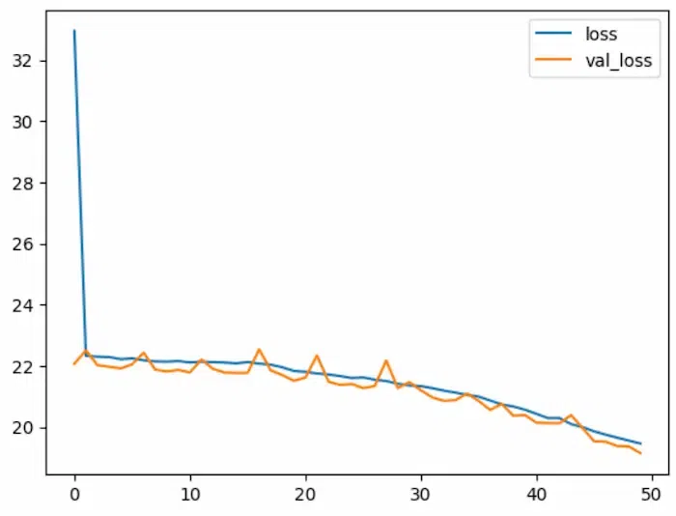
Result:
Fig.1.0 loss and val_loss for ipl score prediction

Slide 16
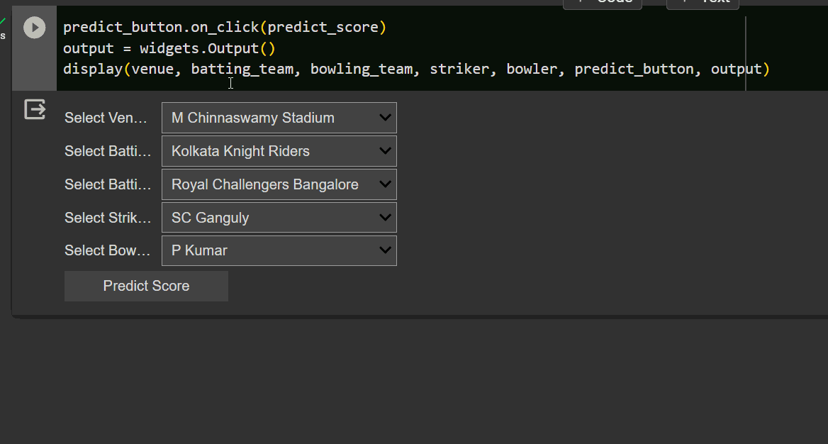
Result:(contd…)
Fig 1.1 Interactive Widget for ipl score prediction

Slide 17
References:
https://www.tensorflow.org/
https://numpy.org/
https://scikit-learn.org/stable/
https://keras.io/
https://matplotlib.org/
https://www.kaggle.com/datasets/patrickb1912/ipl-complete-dataset-20082020

Slide 18
Conclusion:
Through the training process, the GAN learns the underlying patterns and dynamics of cricket matches, including player performance, pitch conditions, team strategies, and various other factors influencing scores. By generating synthetic data and continually improving its predictive capabilities through adversarial training, the GAN algorithm offers a flexible and robust approach to IPL score prediction.The results demonstrate that the GAN algorithm can provide valuable insights into future match outcomes, aiding stakeholders such as team managers, broadcasters, and betting agencies in making informed decisions. However, further refinement and validation of the model are necessary to enhance its accuracy and reliability.

Slide 19
Thank you

